Slide 1
ARM6 Architecture
From: ARM Architecture Reference Manual,
©2005, ARM Ltd.

Slide 2
ARM Design Philosophy
The ARM is a Reduced Instruction Set Computer (RISC), as it incorporates these typical RISC architecture features:
a large uniform register file
a load/store architecture, where data-processing operations only operate on register contents, not directly on memory contents
simple addressing modes, with all load/store addresses being determined from register contents and instruction fields only
uniform and fixed-length instruction fields, to simplify instruction decode.

Slide 3
Benefits of ARM Design Philosopy
The architectural simplicity of ARM processors has traditionally led to very small implement-ations, and small implementations allow devices with very low power consumption. Implementation size, performance, and very low power consumption remain key attributes in the development of the ARM architecture.

Slide 4
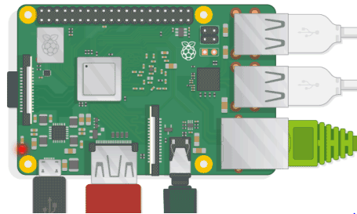
An Example of an ARM computer
The Rasberry Pi
From: https://www.raspberrypi.org/help/

Slide 5
ARM Registers
ARM has 31 general-purpose 32-bit registers. At any one time, 16 of these registers are visible. The other registers are used to speed up exception processing.
Three of the 16 visible registers have special roles:
Stack pointer Software normally uses R13 as a Stack Pointer (SP).
Link register Register 14 is the Link Register (LR). This register holds the address of the next instruction after a Branch and Link (BL or BLX) instruction, which is the instruction used to make a subroutine call.
Program counter Register 15 is the Program Counter (PC). It can be used in most instructions as a pointer to the instruction which is two instructions after the instruction being executed.

Slide 6
Unbanked Registers
Registers R0 to R7 are unbanked registers. This means that each of them refers to the same 32-bit physical register in all processor modes. They are completely general-purpose registers, with no special uses implied by the architecture, and can be used wherever an instruction allows a general-purpose register to be specified.

Slide 7
Banked Registers
Registers R8 to R14 are banked registers. The physical register referred to by each of them depends on the current processor mode. Where a particular physical register is intended, without depending on the current processor mode, a more specific name (as described below) is used. Almost all instructions allow the banked registers to be used wherever a general-purpose register is allowed.

Slide 8
Status Registers
All processor state other than the general-purpose register contents is held in status registers. The current operating processor status is in the Current Program Status Register (CPSR). The CPSR holds, among other items:
four condition code flags (Negative, Zero, Carry and oVerflow).
two interrupt disable bits, one for each type of interrupt.
five bits that encode the current processor mode.

Slide 9

The Condition Field
Most ARM instructions can be conditionally executed, which means that they only have their normal effect if the N, Z, C and V flags in the CPSR satisfy
a condition specified in the instruction. If the flags do not satisfy this condition, the instruction acts as a NOP: that is, execution advances to the next instruction as normal, including any relevant checks for interrupts and Prefetch Aborts, but has no other effect.
.
Every instruction contains a 4-bit condition code field in bits 31 to 28:

Slide 10
Some Condition Field Patterns
Opcode [31:28] | Mnemonic extension | Meaning | Condition flag state
0000 | EQ | Equal | Z set
0001 | NE | Not equal | Z clear
0010 | CS | Carry set | C set
0011 | CC | Carry clear | C clear
0100 | MI | Minus (negative) | N set
0101 | PL | Plus (+ or zero) | N clear
0110 | VS | Overflow | V set
0111 | VC | No overflow | V clear

Slide 11
Branch Instructions
All ARM processors support a branch instruction that allows a conditional branch forwards or backwards up to 32MB. As the PC is one of the general-purpose registers (R15), a branch or jump can also be generated by writing a value to R15.
A subroutine call can be performed by a variant of the standard branch instruction. As well as allowing a branch forward or backward up to 32MB, the Branch with Link (BL) instruction preserves the address of the instruction after the branch (the return address) in the LR (R14).

Slide 12
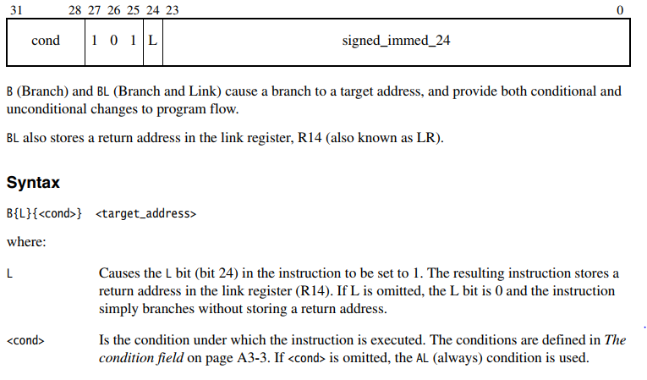
Branch Instruction Encoding
B (Branch) and BL (Branch and Link) cause a branch to a target address.
BL also stores a return address in the link register, R14 (also known as LR).
Syntax
B{L}{<cond>} <target_address>
The branch target address is calculated by:
The 24 bit offset encodes a 8MB two's-complement offset
Because instructions are always 4 bytes wide, and because memory is byte-addressable,
the lowest 2 bits are always zero.
So the effective reach of a branch instruction is +/- 32MB.

Slide 13
Examples of Branch Instructions
B label ; branch unconditionally to label
BCC label ; branch if carry flag is clear
BEQ label ; branch if zero flag is set
MOV PC, #0 ; branch to location zero
BL func ; subroutine call to func
MOV PC, LR ; return from subroutine
MOV LR, PC ; store address of next instruction
LDR PC, =func ; load address into program counter

Slide 14
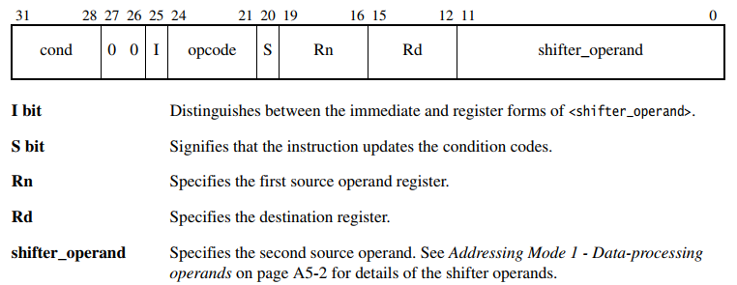
Data Processing Instructions

Slide 15
Data Processing Opcodes
ADC Add with Carry. ADD
AND BIC Bit Clear
CMN Compare Negative CMP Compare
EOR Exclusive OR MOV Move
MVN Move Not ORR OR
RSB Reverse Subtract RSC Reverse Subtract w/ Carry
SBC Subtract with Carry SUB Subtract
TEQ Test Equivalence TST Test
The Data Processing Instructions do not affect the flags unless an 'S' is appended
to the mnemonic.

Slide 16
Immediate Mode Examples
MOV R0, #0 ; Move zero to R0
ADD R3, R3, #1 ; Add one to R3
CMP R7, #1000 ; Compare R7 with 1000
BIC R9, R8, #0xFF00 ; Clear bits 8-15 of R8

Slide 17
Register Mode Examples
MOV R2, R0 ; Copy R0 to R2
ADD R4, R3, R2 ; Add R2 to R3, store in R4
CMP R7, R8 ; Compare R7 and R8

Slide 18
Multiply Examples
MUL R4, R2, R1 ; Multiply
MULS R4, R2, R1 ; Multiply, set N and Z flags
MLA R7, R8, R9, R3 ; Multiply and add
SMULL R4, R8, R2, R3 ; Signed multiply long
UMULL R6, R8, R0, R1 ; Unsigned multiply long
UMLAL R5, R8, R0, R1 ; Unsigned long multiply and add

Slide 19
Multiply Examples
MUL R4, R2, R1 ; Multiply
MULS R4, R2, R1 ; Multiply, set N and Z flags
MLA R7, R8, R9, R3 ; Multiply and add
SMULL R4, R8, R2, R3 ; Signed multiply long
UMULL R6, R8, R0, R1 ; Unsigned multiply long
UMLAL R5, R8, R0, R1 ; Unsigned long multiply and add

Slide 20
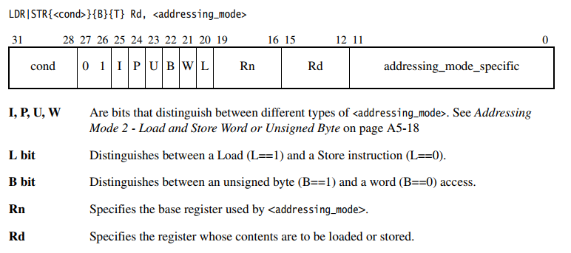
Load and Store Instructions

Slide 21
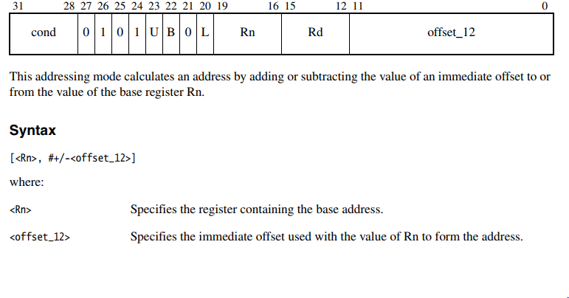
Load and Store, Immed. Offset

Slide 22
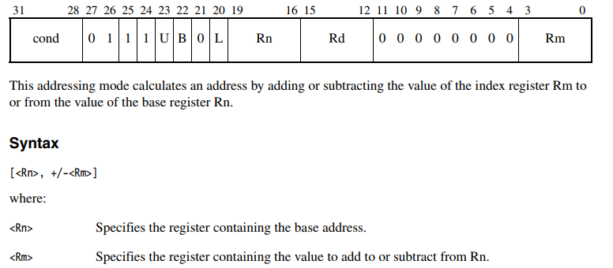
Load/Store, Register Offset

Slide 23
Load and Store Examples
LDR R1, [R0] ; R1 ← M[R0]
LDR R8, [R3, #4] ; R8 ← M[R3 + 4]
LDR R12, [R13, #-4] ; R12 ← M[R13 - 4]
STR R2, [R1, #0x100] ; M[R1 + 0x100] ← R2
LDRB R5, [R9] ; R5[0:7] ← M[R9][0:7]
; (zero top 3 bytes)
LDRB R3, [R8, #3] ; R3[0:7] ← M[R8 + 3][0:7]
; (zero top 3 bytes)
STRB R4, [R10, #0x200] ; M[R10 + 0x200][0:7] ← R4[0:7]
LDR R11, [R1, R2] ; R11 ← M[R1 + R2]
STRB R10, [R7, -R4] ; M[R7 – R4] ← R10
LDR R11, [R3, R5, LSL #2] ; R11 ← M[R3 + R5*4]

